Slide 1
Capstone project week2
Submitted by:
Md Zaid Hasib

Slide 2
Problem Statement:
In this project we will try to find the optimal location for a resturant . Specifically , this will be helpful for stakeholder who are going to open new Italian Resturant in the Kormangla area of Banglore, India
Since there are many resturants in the banglore , we will try to find the area where there are less crowd. And We will also prefer that it wil be close to the city center
We Will use ML algorithm to generate most promising neighbourhood.

Slide 3
Data Extraction:
For data , we will use geopy libraries and used the latitude from the library hen passing the address.
I used folium , library to plot the map from the co-ordinates extracted from geopy .

Slide 4
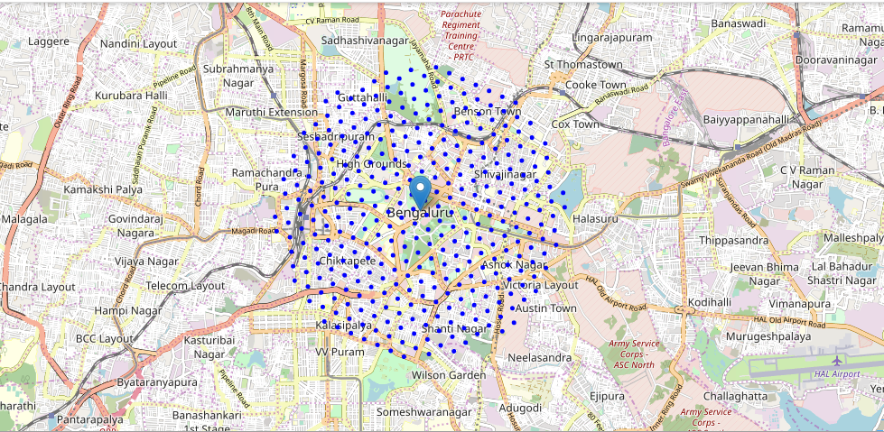
With the use of folium e have created the map of Banglore and point the area into segments. Total area coverage 12x12 . The radius of then segments is 600 m

Slide 5
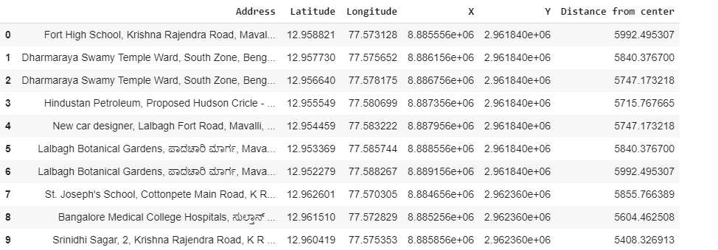
Data extraction from the geopy and putting the segment . Here we will find the co-ordinate of the area of the segments.

Slide 6
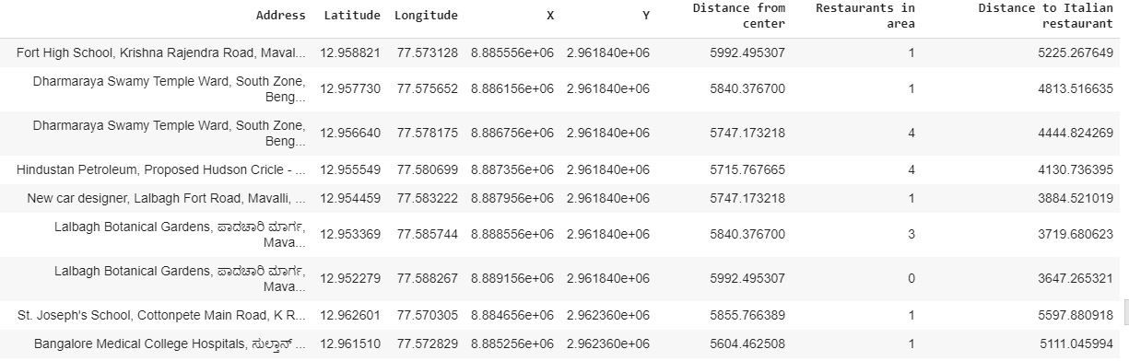
Using four square api, we will find the list of Italian restaurants , we will find the Italian restaurants in the area and appending it into new data frame. Here we will find the distance of the nearby italian resturants.

Slide 7
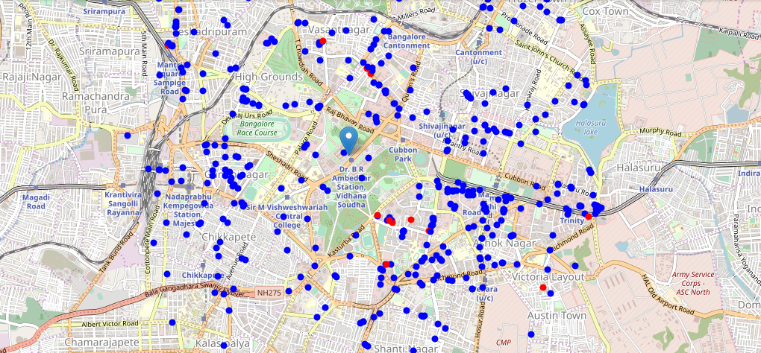
Plot the restaurants in blue and among them red point for the Italian restaurant By the map and the data , we will apply k-means and found the list of segments(area) in Bangalore where opening Italian Restaurant would be beneficial

Slide 8
Conclusion:
Purpose of this project was to identify Banglore areas close to center with low number of restaurants (particularly Italian restaurants) in order to aid stakeholders in narrowing down the search for optimal location for a new Italian restaurant. By calculating restaurant density distribution from Foursquare data we have first identified general boroughs that justify further analysis , and then generated extensive collection of locations which satisfy some basic requirements regarding existing nearby restaurants. Clustering of those locations was then performed in order to create major zones of interest (containing greatest number of potential locations) and addresses of those zone centers were created to be used as starting points for final exploration by stakeholders.
Final decission on optimal restaurant location will be made by stakeholders based on specific characteristics of neighborhoods and locations in every recommended zone, taking into consideration additional factors like attractiveness of each location (proximity to park or water), levels of noise / proximity to major roads, real estate availability, prices, social and economic dynamics of every neighborhood etc.
Thank You!

